Slide 1
Big Mountain Resort Pricing Model
Gayathri Krishnamoorthy

Slide 2


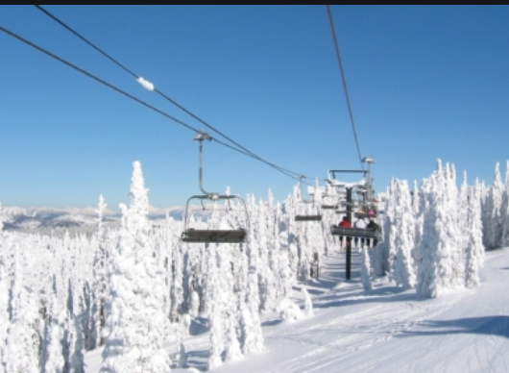

Overview
Big mountain Ski resort, which is in Montana gets 350,000 visitors for every ski season. They recently installed additional chair lifts to increase the visitors across the mountain. The additional chair lifts increased the operational cost by $1,540,000. Big mountain resort must implement a new pricing strategy to increase the revenue and reduce the operational cost.

Slide 3
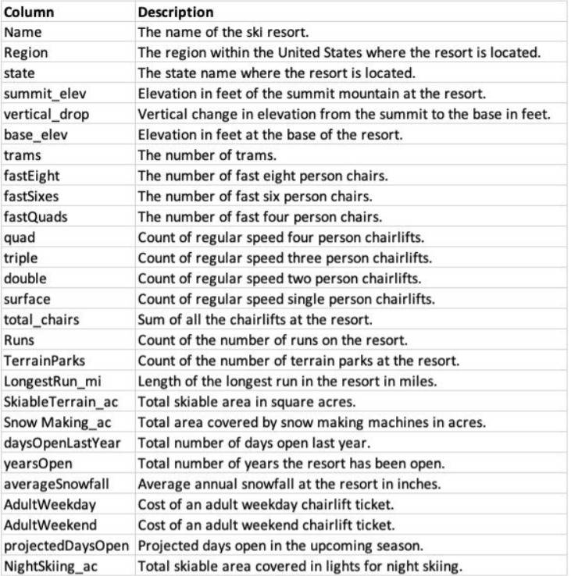
Ski Resort Dataset
The Ski resort data set had 330 rows and 27 columns.
fastEight column with most missing values, at just over 50%.
14% of ticket price values were missing.
Rows with missing values in both ‘AdultWeekday’ and ‘Adultweekend’ columns were removed.

Slide 4
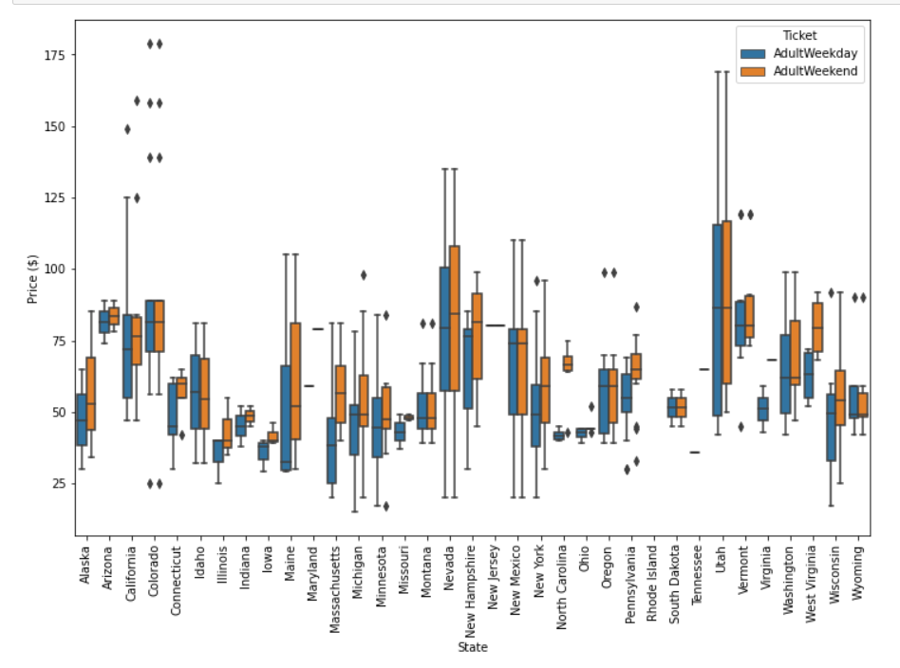
Ticket price distributions
California, Colorado, and Utah lie in a broad range from around 25 to over 100 dollars.
Montana had small variability in the range and same ticket price for both weekday and weekend

Slide 5
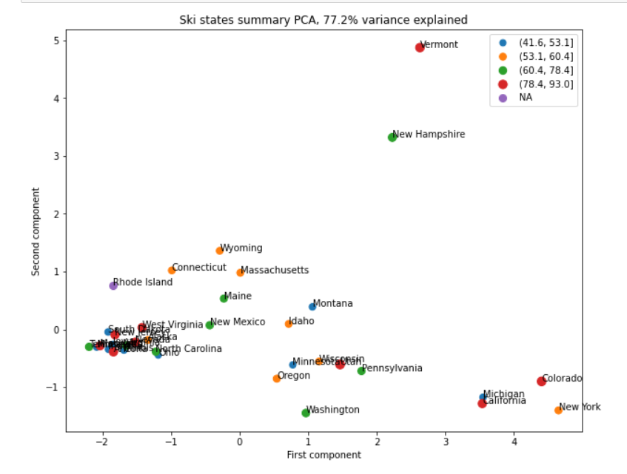
Exploratory Data Analysis
All features reduced to 2 components using PCA
77.2% variance in ticket price explained by all the features

Slide 6

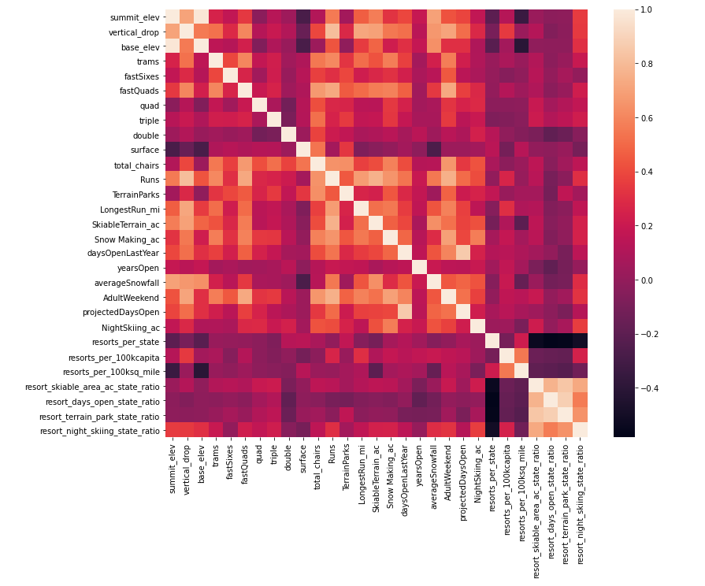

Exploratory Data Analysis
Heatmap of correlations in Ski Data
fastQuads stands out, along with Runs and Snow Making_ac for strong coorelation.
One of the new aggregated feautre resort_night_skiing_state_ratio seems the most correlated with ticket price.

Slide 7
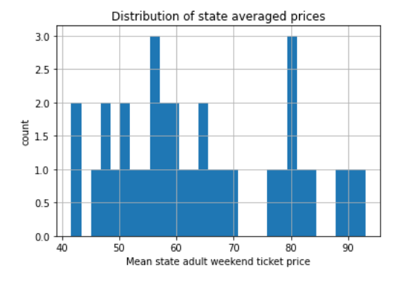
Exploratory Data Analysis
From this average prices of the resorts in the dataset, most of the resorts fall between $40 - $70

Slide 8
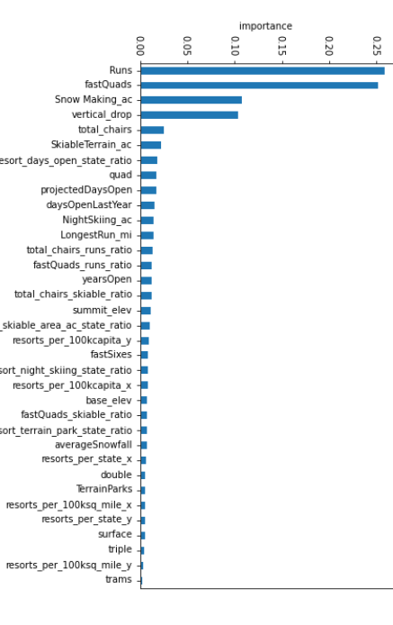
Model Selection
Several models were evaluated and selected RandomForestRegression model.
RandomForest had the advantage of finding the important feature. The important features were displayed in a bar chart. The top 4 features were fastQuads, Runs, Snow Making_ac, vertical_drop.
The RandomForest had the absolute mean error for $1.

Slide 9
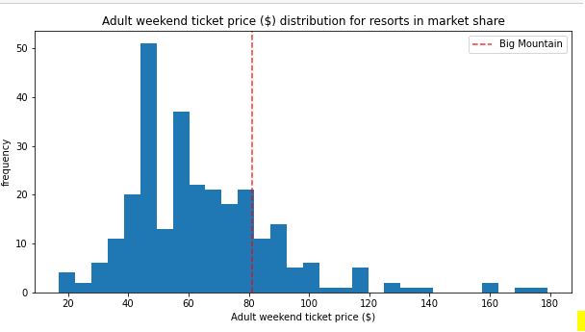
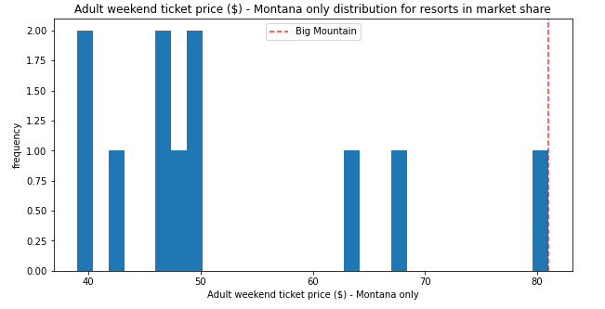
Pricing Model
The current ticket price for Big Mountain resort was $81
Compared to resorts nation wide, Big Mountain was at higher end.
Within Montana, Big mountain was the highest priced resort.

Slide 10
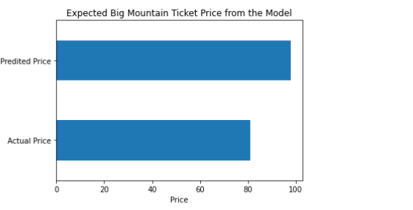
Pricing Model
Big Mountain Resort modelled price was $97.96, actual price was $81.00.
Even with the expected mean absolute error of $10.36, this model suggested there is room for an increase.

Slide 11
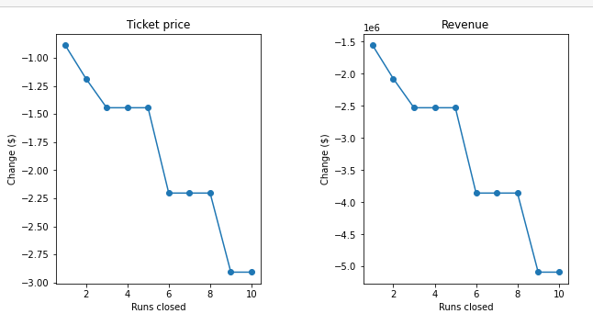
Pricing Model
Scenario 1 – Close down up to 10 ‘Runs’.
There was no difference in the price when we close one run.
No loss in ticket price while closing 4 or 5 runs . When closing 6 or more leads to drop.
5 of the least used runs would be best way to go as we charge less for ticket prices which does provide less revenue.

Slide 12
Pricing Model
Scenario 2 - Add one more ‘Runs’, increase ‘vertical drop’ by 150 feet and adding one additional ‘chairs. This scenario supported increasing the ticket price by $2.22.
Scenario 3 - Repeated the second with an additional 2 acres of snow making. The was no difference from the second scenario.
Scenario 4 - Increased the longest run by .2 miles and adding 4 acres of snow making. There is no difference in the price.

Slide 13
Conclusion
Closing 5 of the least used runs would be best way to go as we charge less for ticket prices which does provide less revenue.
The incurring costs to install a new lift, new snow making capabilities and additional costs of providing the new terrain which certainly would add to the operating costs and lower the revenues.
In this project, only ticket price was considered for modeling. Other costs should be considered for deciding the ticket price.
The price of new chairlift, the price of adding skiable acres, cost of additional snow making should be considered.
Finally, developing framework for where the business could input different combination of features to generate the ticket price. This could potentially help the business to find out how could they increase the revenue by combination of different feature.

